Slide 1
Maintaining Impedance in
Split Core Ferrites for
Low-Frequency Applications
Rachael Parker
Vice President of Fair-Rite Products Corp.

Slide 2

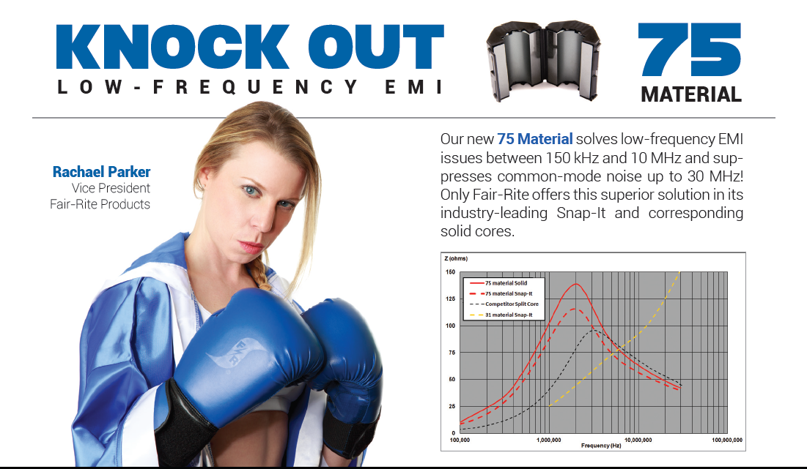
This presentation is brought to you by:
Rachael Parker
Vice President
Fair-Rite Products Corp.
Joining Fair-Rite in 2014,
she holds a BS in Electrical Engineering, an M.Eng in Electrical Engineering, and an MS in Engineering Management.
Rachael spent her early career in product development, project leadership, and program management.

Slide 3
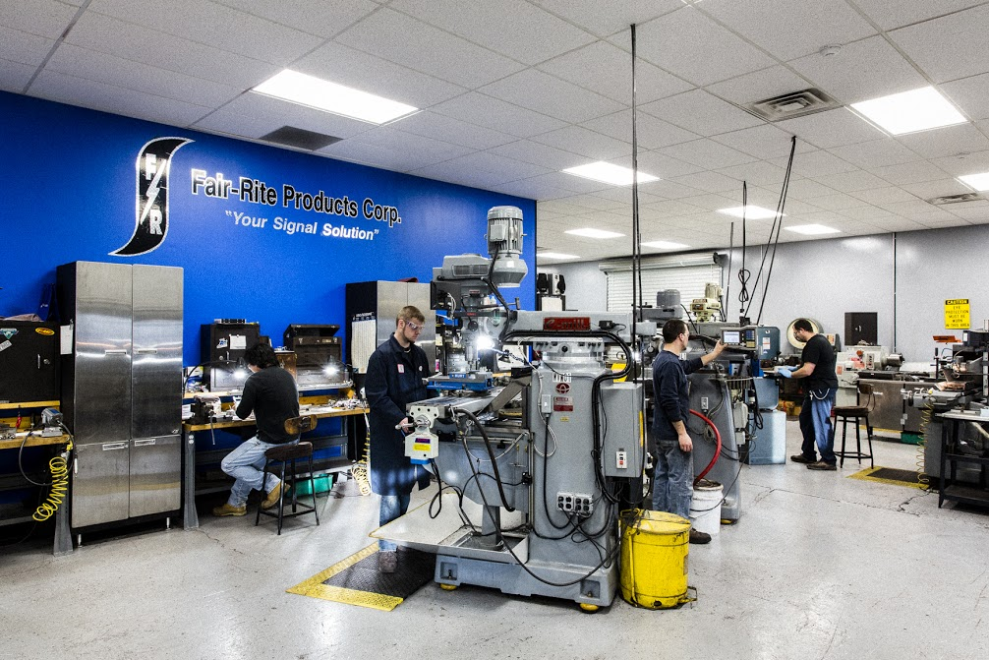
Founded in 1952 – family owned and operated in US and China
Providing ferrite components for the electronics industry
for over 60 years
Wide product offering and materials for:
  EMI Suppression
  RFID-Antennas
  Power/Inductive
  Value Added Services (machining,
  winding, assemblies)
Visit our new website at
www.fair-rite.com

Slide 4



The challenge…
So you’ve made it to the test lab to get your product certified – but you fail!!
  The dreaded questions:
    What is the fix?
    How long will it take?
    How much will it cost??
Notes:
So you’ve made it to the test lab to get your FCC Class B certification – but you fail!!
You picture your product manager screaming and your boss’s disapproving glare… and the dreaded question – HOW SOON CAN WE LAUNCH?

Slide 5
Until now…
To solve low-frequency EMC issues,
Snap-It ferrites were not a viable option
Mind the Gap!

Slide 6
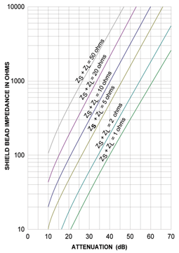
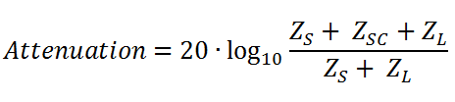
Review: How Ferrites Reduce Noise
Z_{s} = Source impedance
Z_{sc} = Suppressor Core impedance
Z_{L} = Load impedance
Notes:
There are 3 essential elements of any emc problem. There must be a source of an electromagnetic phenomenon (noise), a receptor (victim) that can not function properly due to the noise, and a way the noise couples from source to victim (path)
This shows a typical noise coupling model for emissions and immunity. There is a Source of the noise, a way the noise gets to where it is going, the Path and of course the Load, or victim of the unwanted noise.
SOURCE: Ferrite can be used at the Source to reduce the high frequency content of the noise by providing a series impedance that reduces noise current amplitude.
PATH: ferrite can increase the impedance of the path to provide attenuation between noise source and victim , Load
LOAD: ferrite can increase the input impedance of the victim (or Load) with the goal of reducing noise current amplitude.
Whether used at the SOURCE, the PATH or the LOAD, the ferrite is adding impedance in series with the noise to provide attenuation.
Cores are specified in terms of impedance, but often the end user needs to know the attenuation. The relationship that exists between these two parameters is:
The relationship is dependent on the impedance of the source generating the noise and the impedance of the load receiving it. These values are usually complex numbers that can be infinite in scope and not easily obtained by the designer.
Selecting a value of one ohm for both the load and the source impedance, as may be the case when the source is a switch mode power supply and the load many low impedance circuits, simplifies the equation and allows comparison of ferrite cores in terms of attenuation.
Under these conditions, the equation reduces to :
Attenuation = 20 log10 (Zsc /2) dB

Slide 7

Impedance Formula
L_{s} = series inductance
R_{s} = series loss resistance
L_{o} = air core inductance
µ = material permeability
Material permeability is a frequency dependant characteristic
Notes:
As stated earlier, Impedance is the characteristic provided by the ferrite to suppress EMI (attenuate the noise signal). Now we are going the review the make up of the Impedance and factors that effect the impedance.
At low frequency u’ is dominant factor, so Z is almost entirely inductive.
As frequency increases, u’ begins to drop off, u” (losses) increases and at some point u” becomes the dominant factor, at which point the Z is mostly resistive (or lossy)
Both Rs and XL are proportional to Lo (air core inductance)
Lo is controlled by the square of the turns and by the dimensions of the core [length (or Ht), OD and ID ]. Double the length = double the Lo (& Z), increase OD or decrease ID = increase Lo (& Z) SIZE MATTERS
So it is important to understand what effects complex permeability – but before we do that we will take a moment to review CM & DM currents.

Slide 8
Impedance Formula
Generally, as the initial permeability (µ_{i}) increases, the impedance frequency range decreases
Material | µ_{i} (initial permeability) | Frequency Range
75 | 5000 | 150 kHz – 10 MHz
31 | 1500 | 1 MHz – 300 MHz
43/44 | 800/500 | 25 MHz – 300 MHz
61 | 125 | 200 MHz – 1 GHz
Initial permeability refers to µ when
magnetization levels extremely small
Notes:
As stated earlier, Impedance is the characteristic provided by the ferrite to suppress EMI (attenuate the noise signal). Now we are going the review the make up of the Impedance and factors that effect the impedance.
At low frequency u’ is dominant factor, so Z is almost entirely inductive.
As frequency increases, u’ begins to drop off, u” (losses) increases and at some point u” becomes the dominant factor, at which point the Z is mostly resistive (or lossy)
Both Rs and XL are proportional to Lo (air core inductance)
Lo is controlled by the square of the turns and by the dimensions of the core [length (or Ht), OD and ID ]. Double the length = double the Lo (& Z), increase OD or decrease ID = increase Lo (& Z) SIZE MATTERS
So it is important to understand what effects complex permeability – but before we do that we will take a moment to review CM & DM currents.

Slide 9
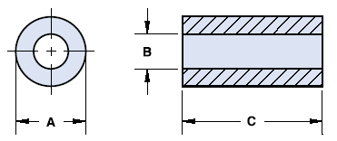
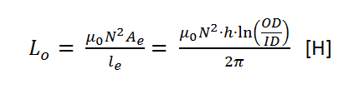
Impedance Formula
L_{s} = series inductance
R_{s} = series loss resistance
L_{o} = air core inductance
µ = material permeability
ID
OD
h
[Dim– mm]
Ae = effective cross-sectional area
l_{e} = effective magnetic path length
µ₀ = permeability of free space
N = number of turns
Notes:
As stated earlier, Impedance is the characteristic provided by the ferrite to suppress EMI (attenuate the noise signal). Now we are going the review the make up of the Impedance and factors that effect the impedance.
At low frequency u’ is dominant factor, so Z is almost entirely inductive.
As frequency increases, u’ begins to drop off, u” (losses) increases and at some point u” becomes the dominant factor, at which point the Z is mostly resistive (or lossy)
Both Rs and XL are proportional to Lo (air core inductance)
Lo is controlled by the square of the turns and by the dimensions of the core [length (or Ht), OD and ID ]. Double the length = double the Lo (& Z), increase OD or decrease ID = increase Lo (& Z) SIZE MATTERS
So it is important to understand what effects complex permeability – but before we do that we will take a moment to review CM & DM currents.

Slide 10
Impedance Formula
Core performance also depends on geometric and implementation parameters as part of L_{o}:
Parameter | Description | As parameter is increased, Z will…
N | Number of times the cable passes through aperture the core | Increase by N²
OD | Outer Diameter of the core | Increase linearly
ID | Inner Diameter of the core | Decrease linearly
H | Height of the core | Increase linearly
Notes:
As stated earlier, Impedance is the characteristic provided by the ferrite to suppress EMI (attenuate the noise signal). Now we are going the review the make up of the Impedance and factors that effect the impedance.
At low frequency u’ is dominant factor, so Z is almost entirely inductive.
As frequency increases, u’ begins to drop off, u” (losses) increases and at some point u” becomes the dominant factor, at which point the Z is mostly resistive (or lossy)
Both Rs and XL are proportional to Lo (air core inductance)
Lo is controlled by the square of the turns and by the dimensions of the core [length (or Ht), OD and ID ]. Double the length = double the Lo (& Z), increase OD or decrease ID = increase Lo (& Z) SIZE MATTERS
So it is important to understand what effects complex permeability – but before we do that we will take a moment to review CM & DM currents.

Slide 11
Putting it all together…
Low frequencies → L_{s} is main driver of impedance.
High frequencies (> 1MHz)→ R_{s} is main driver of impedance

Slide 12
Solid Suppression Core Comparison
Notes:
75-material provides enhanced impedance at lower frequencies as compared to other materials offered by Fair-Rite Products.

Slide 13

Challenges
Test facilities had implementation difficulties with solid cores.
Notes:
Since 75-material was only available in solid-cores, test facilities found it difficult to implement without de-terminating cables.

Slide 14
Challenges
Performance was degraded in split cores due the high permeability material (e.g., µ_{i} = 5000)

Slide 15
Impedance with an Air-Gap
Air-gap in the magnetic circuit reduces the inductance.
  l_{e} needs to be considered separately.
Core behaves as if it has reduced permeability, known as its effective permeability.
  Permeability is dependant on both the magnetic path length and the air gap.

Slide 16
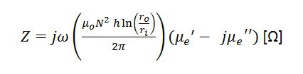

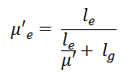


Impedance with an Air-Gap
Assuming gap length (l_{g}) << magnetic path lengh (l_{e})
tan(δ) refers to the magnetic loss tangent and represents the inefficiency of the system based on the angle between the µ’ and µ’’.

Slide 17
Effect on Permeability

Slide 18
So what??
For a high-permeability such as 75-material, even the smallest gaps can degrade performance tremendously!
* Based on a specific core size

Slide 19
Minimizing the air-gap

Slide 20
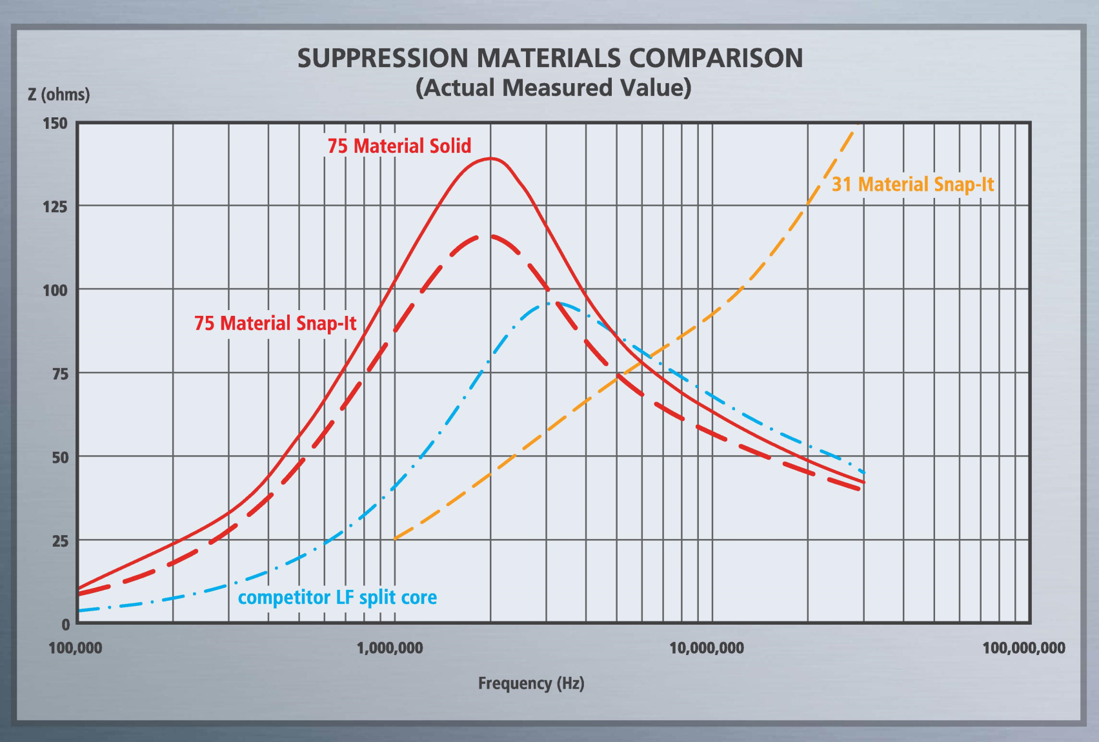
The solution!

Slide 21
Design Considerations
DC Bias
  Derating can occur at high current levels, so
  ferrites are ideal for common-mode noise issues.
  When applicable, both current-carrying conductors should pass through the core.

Slide 22
Design Considerations
Operating Temperature
  µ_{i} for 75-material can change 0.6% per degree Celsius in an operating range from 20° - 70°C.
  µ_{i} for 31-material can change 1.6% per degree Celsius in an operating range from 20° - 70°C.

Slide 23

Thank You!
Questions?

